Slide 1




Enhancing InfoGAN with Regularization Techniques for Improved Feature Disentanglement and Implementing Counterfactual Generative Networks
Course: INFO6105 – Data Science Engineering Tools and Methods
Instructor: Akash Murthy
Team Members:
Aakash Belide
(002315683)
Himank Arora
(002304366)
Yuchen Huang
(002302851)
Notes:
Good evening everyone, I’m Himank Arora, and along with Aakash and Yu-Chen, are presenting our final project for the course INFO6105.
Our work focuses on two major models:
First, enhancing InfoGAN with new regularization techniques for improved feature disentaglement (to improve how well it can learn and separate visual features,
And second, implementing Counterfactual Generative Networks or CGNs to better understand and control components of generated images like shape, texture, and background.
I’ll start by introducing InfoGAN.

Slide 2
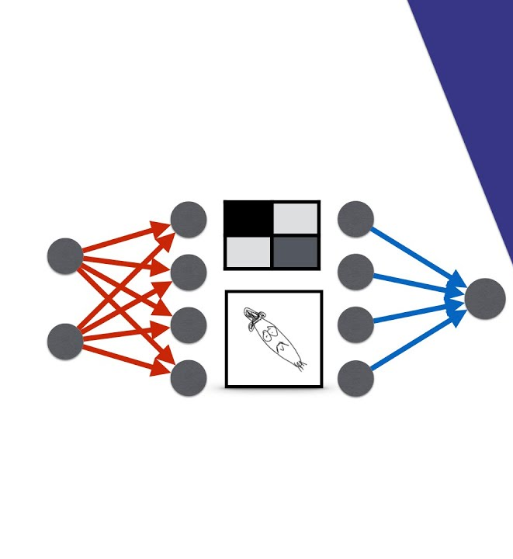

InfoGAN Introduction
InfoGAN Background:
Unsupervised learning aims to extract meaningful features from unlabeled data without explicit guidance. Generative Adversarial Networks (GANs) have emerged as powerful tools for this purpose, but they often learn entangled representations where changes in one input affect multiple output features. InfoGAN, introduced by Chen et al. (2016), addresses this limitation by incorporating an information-theoretic regularization that encourages the generator to preserve information about specific latent codes.
Enhancements:
1
Orthogonal Regularization (OR): Encourages orthogonality between weight vectors in neural networks, leading to more independent latent factors.
Contrastive Regularization (CR): Ensures consistency in latent space by comparing pairs of generated samples with specific latent code changes.
2
Notes:
So, what exactly is InfoGAN and why did we choose it?
InfoGAN is a type of Generative Adversarial Network that improves traditional GANs by giving us a way to control parts of the generated image — lets’s say, rotation or thickness by using something called latent codes.
However there is a small problem, that even with InfoGAN, these controls or 'dials' sometimes overlap. For eg, One code might affect both tilt and thickness together, which defeats the purpose of having independent features.
So our motivation was simple to make each dial control just one specific feature.
To achieve this, we introduced two techniques:
Orthogonal Regularization, which encourages different features to stay independent — like separating tilt from width.
And Contrastive Regularization, which helps the model clearly recognize what changes when a specific code is tweaked.

Slide 3
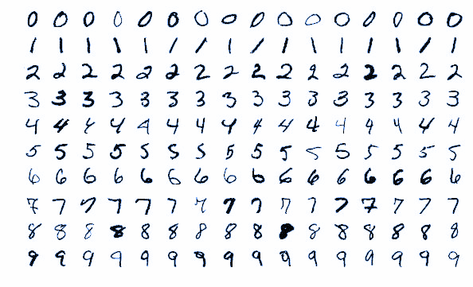


InfoGAN Data Description
Dataset
MNIST Digits Dataset
Handwritten digits (0-9)
Miscellaneous
28 x 28 pixels
Grayscale images
Images resized to 32 x 32
Pixels values are normalized to [-1, 1]
Notes:
To train and test our InfoGAN model, we used MNIST dataset, which includes handwritten digits from 0 to 9.
Each image is originally 28 by 28 pixels in grayscale. We resized them to 32 by 32 and normalized the pixel values between -1 and 1 — which is standard for training deep learning models.
Our goal here was to check if InfoGAN could learn independent features like:
Tilt of a digit,
Stroke thickness,
Or general style.

Slide 4
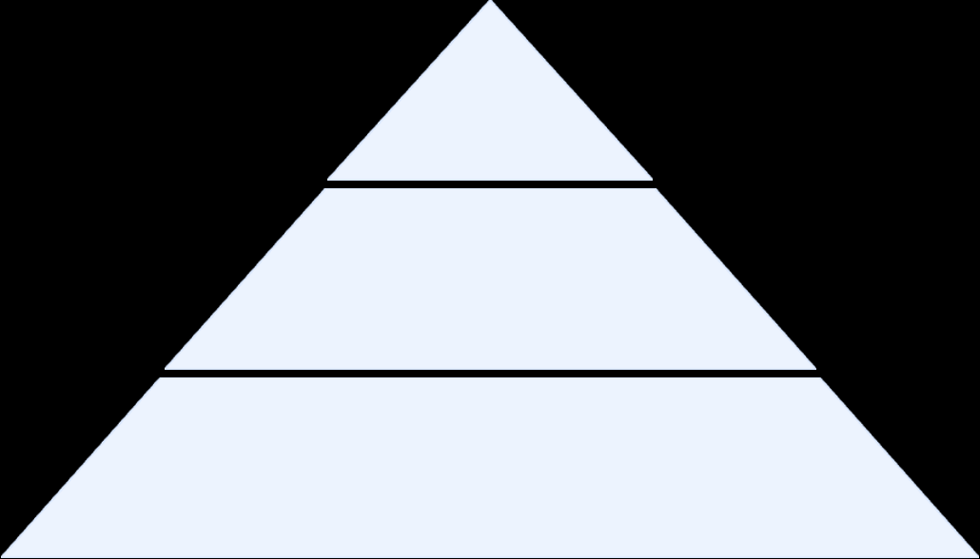
InfoGAN Methodology
Naive InfoGAN (Baseline)
Generator: A neural network that takes as input a noise vector z (dimension 62), a categorical code c1 (one-hot encoded, 10 dimensions), and continuous codes c2 and c3 (each 1 dimension).
Discriminator/Q Network: A shared convolutional neural network that branches into two outputs: the discriminator output that classifies images as real or fake, and the Q network that predicts the latent codes from generated images.
1
Variants
InfoGAN-OR: InfoGAN with Orthogonal Regularization, which encourages orthogonality between the weight vectors of the network, leading to more independent factors.
InfoGAN-CR: InfoGAN with Contrastive Regularization, which ensures consistency in latent space by comparing pairs of generated samples with specific latent code changes.
InfoGAN-ORCR: Combination of both Orthogonal and Contrastive Regularization.
2
Training
Trained for 30 epochs
Learning rate = 0.0002
β1 = 0.5, and β2 = 0.999
3
Notes:
We have our baseline InfoGAN which is the exact implementation as shown in the paper. It is similar to a GAN or Vanilla GAN but unlike a normal GAN, the Generator takes the input random noise, categorical latent code and continuous latent codes. The categorical latent code is one-hot encoded which represents the digit, then we have twoo continuous latent code which represent the width and rotation of the digit.
The Generator takes these as input and generates a realistic image and preserves the information of the latent codes in the generated image.
The Discriminator then takes in this realistic image and unlike GAN where it only identifies it it’s a real or fake image, the GAN additional estimates or predicts the categorical and continuous latent codes from the generated image it self. These latent codes are then used to calculate the auxiliary loss and provides feedback for both the Generator and Discriminator.
We have tried integrating Orthogonal and Contrastive regularization for enhancing the disentangelment for better feature independence. We have separately implemented the Orthogonal, Contrastive regularization and then a combined version or Orthogonal and Contrastive regularization to compare various metrics.
Orthogonal regularization makes sure that the change in one feature doesn’t effect the other features in generating the image basically if they are independent of each other while Contrastive regularization makes sure that a change in one feature has an actual effect in the generated image at the same time does not affect other features.
We trained the model for 30 epochs with a learning rate of 0.0002. The Adam optimizers with beta 1 as 0.5 and beta 2 as 0.999.

Slide 5
InfoGAN Results
Model | Categorical Accuracy | Continuous Correlation | Disentanglement Score | Factor Independence (Inverted) | Traversal Linearity | Categorical MI | Continuous MI | Training Time (min)
InfoGAN | 0.9960 | 0.9042 | 0.1993 | 0.3910 | 0.9015 | 1.0000 | 0.8447 | 20.62
InfoGAN-OR | 1.0000 | 0.9115 | 0.1927 | 0.3746 | 0.8771 | 0.9976 | 0.9331 | 39.12
InfoGAN-CR | 0.9920 | 0.9055 | 0.1963 | 0.3400 | 0.8572 | 0.9927 | 1.0730 | 29.97
InfoGAN-ORCR | 1.0000 | 0.9131 | 0.2005 | 0.4068 | 0.8520 | 1.0000 | 1.0051 | 47.37
InfoGAN-ORCR, combining both regularization techniques, demonstrated the best overall performance across most metrics, particularly in categorical accuracy, continuous correlation, and disentanglement score. However, this came at the cost of increased training time and reduced factor independence.
Notes:
Here are the results for different variants of InfoGAN implementations. Here, the: Categorical Accuracy: measures the proportion of samples where the predicted categorical code matches the true categorical code. So higher the better.
Continuous Correlation: Continuous correlation measures the Pearson correlation coefficient between the true continuous latent codes and their predicted values. So higher it is the better.
Disentanglement Score: measures how exclusively each latent dimension controls one feature in the generated images. A high disentanglement score means that when you change the "rotation" code, only the rotation of the digit changes, without affecting digit identity or width.
Factor Independence (Inverted): Factor independence measures cross-correlations between different latent factors by analyzing how changes in one factor affect others. Lower values indicate less interference. But here I subtracted it from 1 which is indicated by the inverted. So higher the value is better here.
Traversal Linearity: Traversal linearity measures the consistency of changes when moving through latent space, calculated by analyzing the variance in the distances between adjacent points in a latent space traversal. Traversal linearity tells you how smoothly things change when you gradually adjust a control knob.
Categorical MI: Categorical mutual information tells you how much information about the input category (e.g., digit identity) is preserved in the generated image. Higher values mean more information is preserved.
Continuous MI: Continuous mutual information tells you how much information about the input continuous variables (like rotation or width) is preserved in the generated image. Higher values mean more information is preserved.
As you can see, most of the metrics are better for the combined variant. Looking at the metrics, we can also say that the Orthogonal regularization is majorly contributing for better disentanglement which is the feature independence.

Slide 6
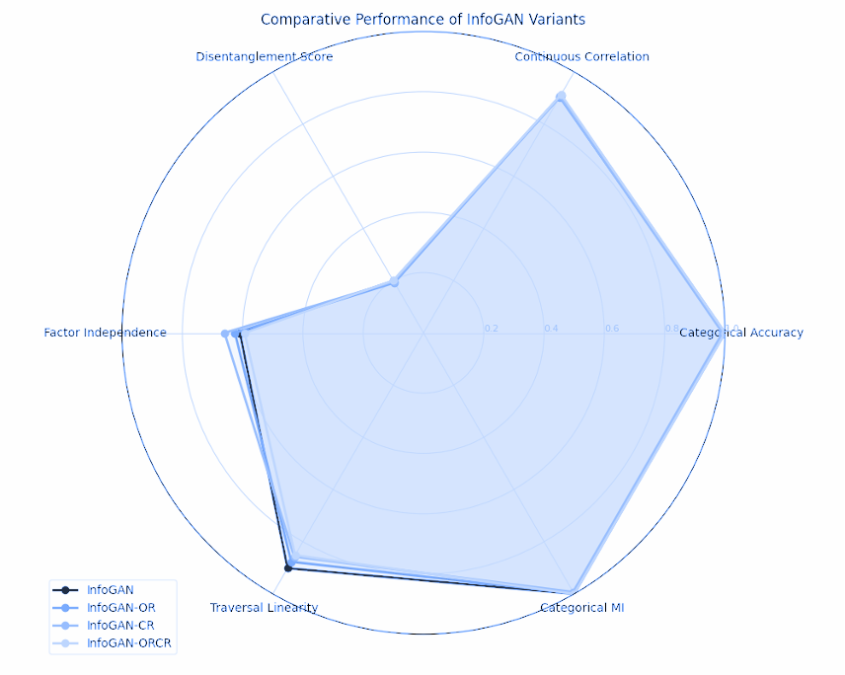
InfoGAN Results

Slide 7

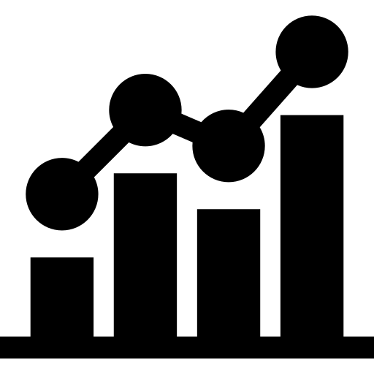
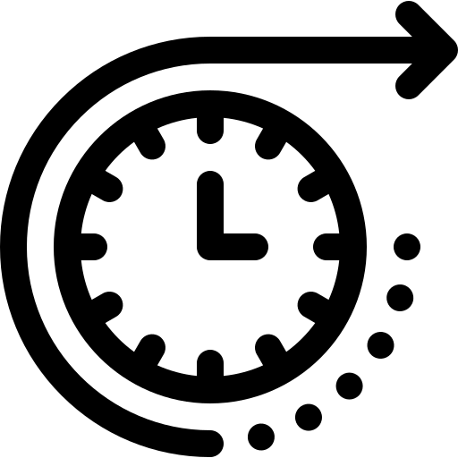
InfoGAN Conclusion
Insights
InfoGAN-ORCR demonstrates superior performance in disentanglement but requires longer training time. Contrastive regularization significantly improves factor independence while orthogonal regularization enhances categorical accuracy.
Model Metrics
InfoGAN-ORCR achieves perfect categorical accuracy (1.0000) and the highest disentanglement score (0.2005). InfoGAN-CR excels in continuous mutual information (1.0730) and factor independence (0.3400).
Future Work
Integrating adaptive weighting of regularization terms during training could enhance the whole process. Apart from this, we can extend the approach to handle a larger number of latent factors.
Notes:
In conclusion, InfoGAN combines both Orthogonal and Contrastive Regularization, which gave us the best results for separating features, but it took longer to train the model. Contrastive Regularization helped to keep features independent, while Orthogonal Regularization improved the model’s accuracy in recognizing categories, like digit types.
InfoGAN-ORCR achieved perfect categorical accuracy and the highest disentanglement score, while InfoGAN-CR was best at handling continuous features and keeping factors separate.
For future work, we can explore adjusting the strength of these regularizations during training to improve results, and also apply this method to more complex features.

Slide 8
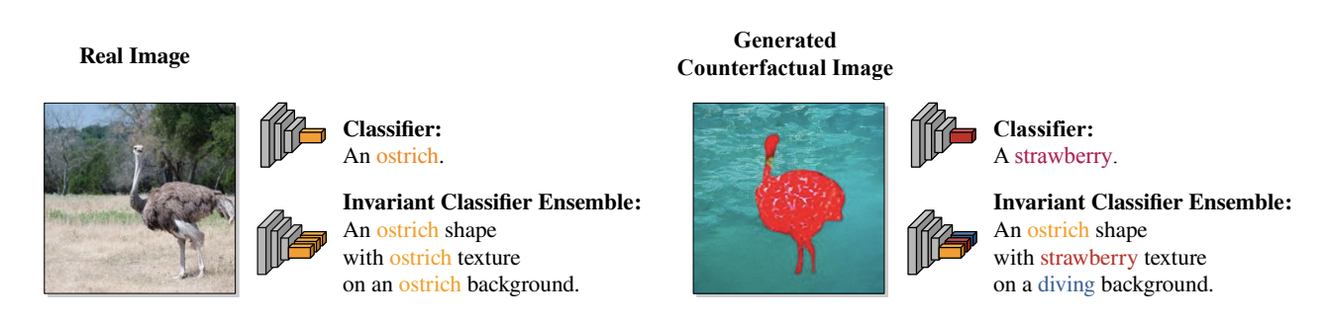
Counterfactual Generative Networks (CGN) Implementation on Colored MNIST
Notes:
Talking about the second model of our project — we worked on implementing Counterfactual Generative Networks, or CGNs, using the Colored MNIST dataset.

Slide 9
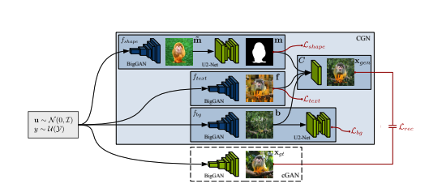
CGN Introduction
Why CGN?:
Deep learning models often rely on shortcuts like texture or background, not true object understanding.
CGN addresses this by generating images disentangling:
Shape
Texture
Background
Project Goals:
1
Implement Counterfactual Generative Networks
Train CGN on a Colored MNIST dataset
Monitor training with:
Loss curves
Mask statistics
Generated image samples
2
3
Notes:
The main idea behind CGN is to improve how models understand images by separating shape, texture, and background.
Deep learning models often pick up on shortcuts like colors or backgrounds, rather than focusing on the object itself.
So, CGN generates images where these components are disentangled.
Our goals were to:
Implement the CGN architecture,
Train it on Colored MNIST,
And monitor the training through loss curves, mask behavior, and generated image samples.

Slide 10
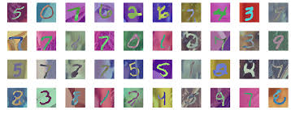
CGN Data Description
Dataset
Coloured MNIST Digits Dataset
Based on MNIST handwritten digits.
Each digit is colorized:
Foreground: Random colors by digit class.
Background: Randomly assigned colors.
Attributes
Images resized to 32 x 32 pixels
Normalized to [-1, 1]
Data prepared in PyTorch Dataloader
Notes:
We are using the Coloured MNSIT Digits dataset which contain foreground and background of random colours. The images are resized to 32 x32 pixels and normalized to -1 to 1

Slide 11
CGN Methodology
CGN Architecture
Shape Generator → Produces masks (where the digit appears)
Texture Generators:
One for foreground (digit texture)
One for background
Discriminator → Tells real from fake images
1
Loss Functions
Adversarial Loss (MSE) → Make images realistic
Binary Mask Loss → Encourage meaningful masks
Perceptual Loss → Match styles of real images
2
Training
20 epochs, batch size 64
Optimized with Adam optimizer
Saved images and losses during training
3
Notes:
Coming to the CGN architecture, it involves 3 Generators, one for the shape of the digit, one for the foreground and another for the background. We use Adversarial Loss which pushes the model to create realistic images. Binary Mask Loss ensures masks clearly show object boundaries. Perceptual Loss helps generated images match the style of real ones.
1. CGN Architecture
The network splits image generation into separate components:
A Shape Generator creates masks showing where the main object (like a digit) appears
Texture Generators handle appearances - one for the object itself and another for the background
A Discriminator checks if images look real or fake
2. Loss Functions
Multiple specialized losses guide the training:
Adversarial Loss pushes the model to create realistic images
Binary Mask Loss ensures masks clearly show object boundaries
Perceptual Loss helps generated images match the style of real ones
3. Training Process
The practical implementation involves:
Training for 20 epochs with batches of 64 images
Using the Adam optimizer to update the model
Saving sample images and tracking losses to monitor progress

Slide 12
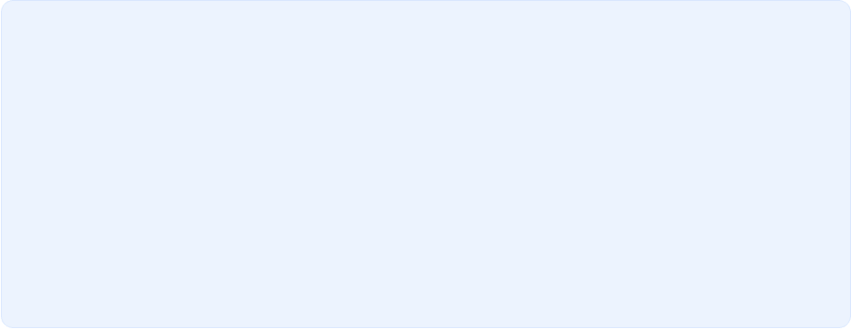
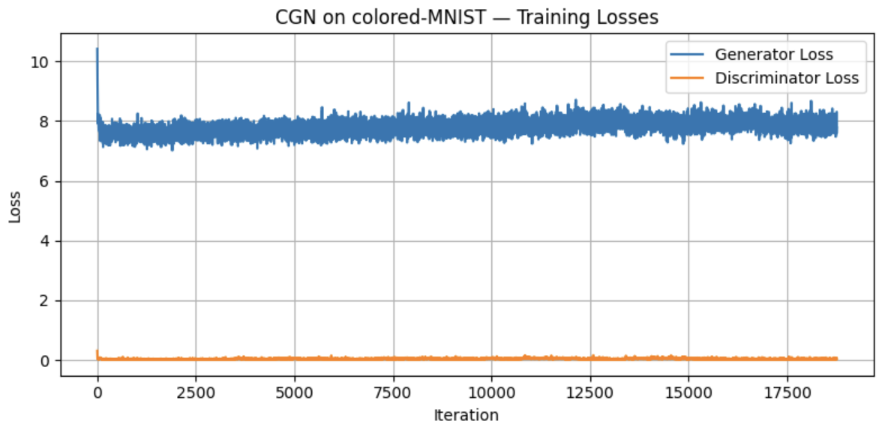
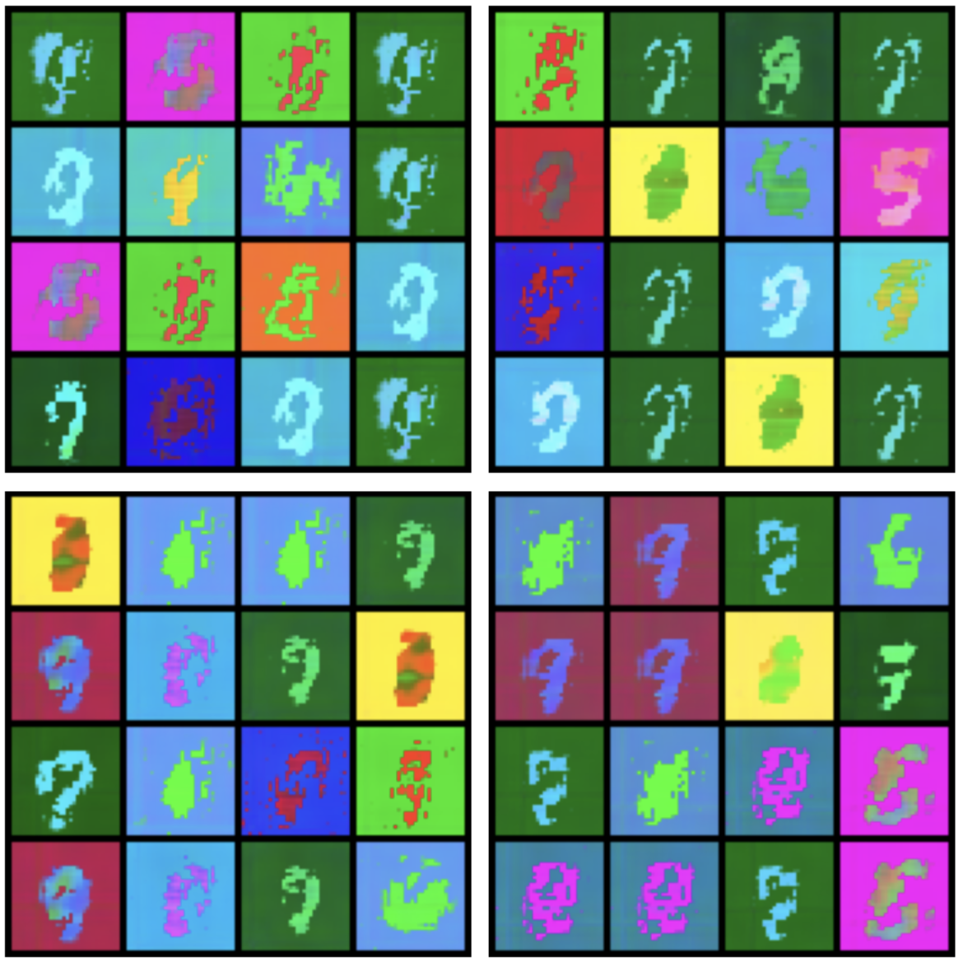
CGN Results
Generated Images
Diverse shapes, textures, backgrounds
Clear digit identity even with color changes
Disentanglement of visual components works well
Training Loss Curves
Generator Loss: Stabilized between 7.5 – 8
Discriminator Loss: Stayed low, ~0.2
Healthy balance → Stable CGN learning
Mask Statistics
Mean Mask Value: Between 0.20 – 0.45
Variance: Between 0.16 – 0.22
No mask collapse → Good diversity and blending
Notes:
Here are the key results from our CGN implementation. The generated images show that the model created digits with varied shapes, textures, and backgrounds, while keeping the digit identity clear. This proves the model successfully disentangled these visual elements.
Looking at the training loss curves, the generator’s loss stayed steady between 7.5 and 8, and the discriminator’s loss was low, around 0.2—showing stable training.
For the mask statistics, the mean mask value ranged from 0.20 to 0.45, with good variance. This means the masks were diverse, and we didn’t see any collapse, which helped the model blend foreground and background well.

Slide 13


CGN Conclusion
Key Achievements
Successfully implemented and trained CGN.
Learned to control shape, texture, and background independently.
Stable training → Disentangled and diverse image generation.
Why it Matters
Helps models learn causally structured images.
Useful for robust classifiers.
Promotes better generalization by avoiding spurious correlations.
Notes:
in conclusion, we successfully implemented and trained the CGN model. The key achievement here is that we learned to control shape, texture, and background separately, which allowed us to generate diverse and disentangled images. The training was stable, and the model didn’t collapse, which means it learned to combine visual components meaningfully.
CGNs help models focus on causally structured images, so instead of relying on shortcuts like background texture, models can truly learn the shape of objects. This is really helpful for building more robust classifiers that can generalize better and avoid being tricked by spurious patterns in the data.

Slide 14

Thank You!

